Slide 1
Ames Housing Sale price
Breakout Room 2:
Anastasiya, Bryan, Jamie,
Qiwen, Russell, Sheng Jun

Slide 2
Guiding questions
Problem Statement
Main
What is the price of the new property?
Additional
Does an increase of Overall Quality of property affect the sale price?
Does the price vary with different House Style?
Does older property cost less than newer ones?
Who ?
House owners, Landlords, Real estate agents & Clients
Problem ?
Short and long-term financial planning due to the volatility of the housing market
Solution !
Regression models (Linear, Lasso and Ridge)
Notes:
Stakeholders struggle in both short and long-term financial planning due to the volatility of the housing market, with many features impacting their prices
To help provide certainty in price prediction for the stakeholders, we developed and picked the best Regression models (Linear, Lasso and Ridge) to uncover variables that have a strong influence on price and are capable of predicting future values.
The Regression models (Linear Regression, Lasso Regression and Ridge Regression) were used for price prediction based on features from provided Dataset (CSV files). The performance of the model was gauged with R2 value.

Slide 3
Data Cleaning & Feature Engineering
Source:
Ames, Iowa, USA
2006 - 2010
Null Value Imputation
Convert Data Types
New Columns
Mean for Continuous Variables (Lot Frontage)
Existence for Categorical (Garage and Basement)
Removed columns more than 50% Null (Pool QC)
Categorical Data into integer (BsmtExposure:
Good Exposure 4
Average Exposure 3
Minimum Exposure 2
No Exposure 1
No Basement 0)
Age (Year Sold - Year Remodelled)
Square Feet (Garage + Basement + 1st/2nd Floor SF)
Notes:
A real estate market Dataset from Kaggle was used to identify and study the features which can contribute the most into the price (in US$) prediction of property in Ames, Iowa, USA. The Dataset comprises sales from 2006 to 2010.
23 nominal
23 ordinal
13 discrete
20 continuous
For null-value, cross-checking of validity of null-values is carried out (e.g. garage type ‘NA’ vs. garage area ‘NaN’).

Slide 4
Exploratory Data Analysis
and
Feature selection

Slide 5
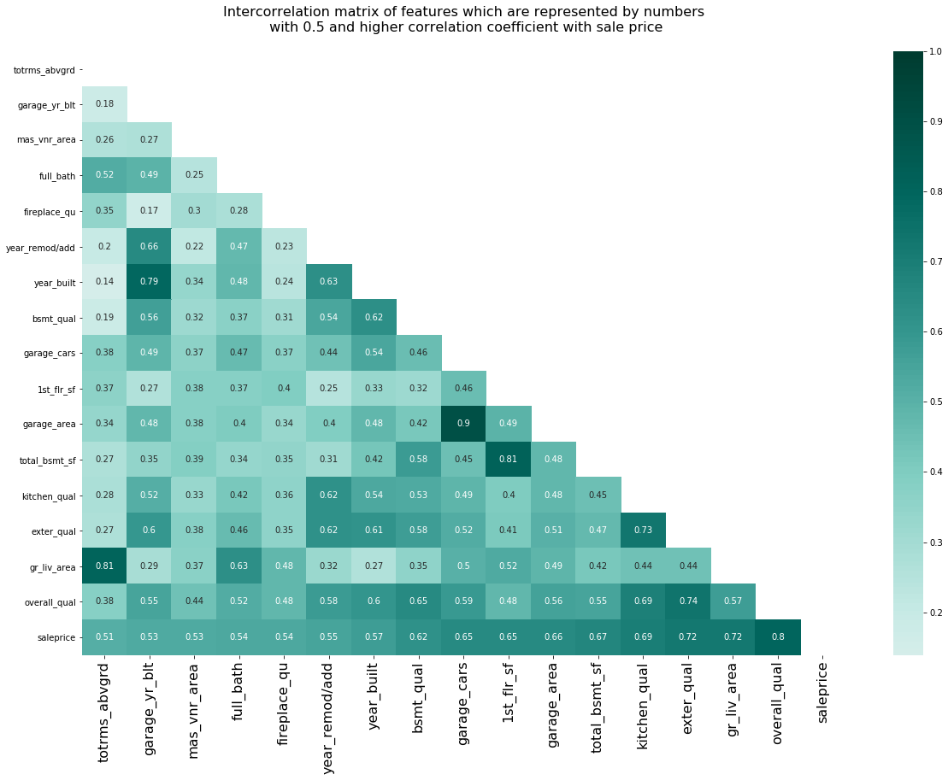
Selecting Numerical Variables
High corr
Top correlation to Sale Price
Blue - Quality
Overall Quality 80% Corr
Red - Area
Garage, Basement, Floor space above 60% Corr
Green - Age
Year Built/Remodelled above 50% Corr
Multicollinearity
Low corr

Slide 6
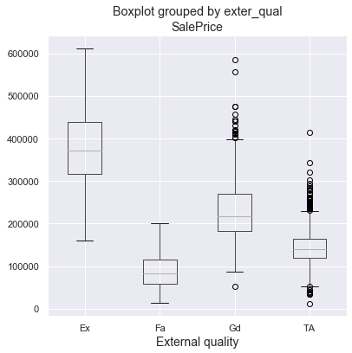
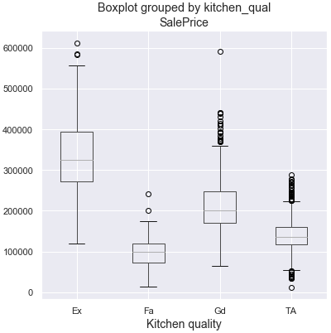
Selecting Categorical Variables
Feature engineering candidates :
Meaningful distribution by classes to sale price
External material quality
Kitchen quality
Notes:
For categorical variables, we review the distribution in saleprice by their classes for presence of significant variance in distribution. Thereafter, feature engineering is carried out for these shortlisted variables.

Slide 7
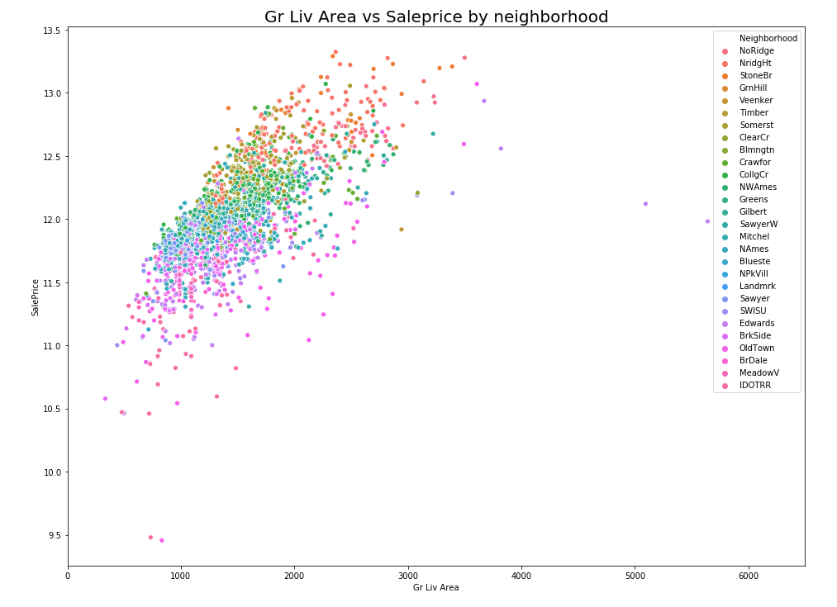
EDA: Linearity of Variables to Sale price
Gr Liv Area vs sale price by neighborhood
Homoscedastic
Positive Correlation with Sale Price
Removed two outliers to prevent overfitting
outliers
Notes:
Neighborhood - important categorical feature -> different neighborhood greatly influences the sale price

Slide 8
Model Fitting
and
Evaluation

Slide 9
Modeling Overview
Training
Training subset
Validation
Test
Split into subsets, Cross-validate
2. Evaluate models
Baseline
LinearRegression
Ridge
Lasso
3. Fit features learnt from entire train data to Test set
Evaluation metrics (against Baseline):
Root Mean Square Error (RMSE)
Coef. of Determination (R2)
Notes:
Our training data is split into training subset and holdout sample for validation. Cross-validation is then done for Linear Regression, Ridge and Lasso models. Using metrics coef of Determination R2 and Root Mean Square Error (RMSE), we evaluate the models against the Baseline model.
Lastly, we fit features learnt from the entire train data to test set.

Slide 10
Model Evaluation
Model Scores | Root Mean Squared Error (lower is better) Train_test_split | R² (0 to 1) Train_test_split | R² (0 to 1) Cross-val_score
Baseline | 79,309 | 0 | -
LR Model | 25,505 | 0.8966 | 0.884
Lasso | 25,556 | 0.8967 | 0.884
Ridge | 25,597 | 0.8958 | 0.884
Notes:
Based on the evaluation, Linear Regression performed the best with lowest root mean squared error and a good R2 score.
To talk about how many features (27 variables) were fit. The metrics are based on fitting entire test data onto test data for prediction.

Slide 11
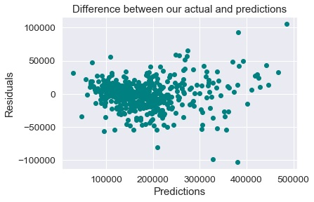
Predictions vs. Actuals
Low residuals around highest distributed price range (150K - 200K)
High residuals for outlier prices (one-off categorical factors affecting price greatly)
Notes:
Here, you can see the residuals of actual and predicted prices have a homoscedastic distribution.
In the red circle, you can see low residuals are around highest distributed price range of 150-200k
However, it is not really random because of the outliers in blue circles. The high residuals for the outlier prices have one-off categorical factors that greatly affect the price.

Slide 12
Guiding questions
Problem Statement
Main:
What is the price of the new property?
Additional:
With an increase of Overall Quality of property does price increase?
Does the price vary with different House Style?
Does older property cost less than newer ones?
Who ?
House owners, Landlords, Real estate agents & Clients
Problem ?
Short and long-term financial planning due to the volatility of the housing market
Solution !
Regression models (Linear, Lasso and Ridge)
Notes:
Referring back to our guiding question on predicting property price, in the next slide, we can see...

Slide 13
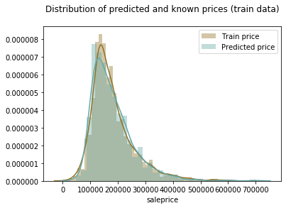
Predictions
The distributions of predicted price and known sale price are overlapped. It means that the range, mean and median are similar.
Notes:
that the distribution of predicted prices of test data and known prices in our train data are of similar distribution, with similar range, mean and median. And that smaller prices are more common that high price.
We can be confident of our model (built on train data) for predicting the test data.

Slide 14
Conclusion
and
Recommendations

Slide 15
Guiding questions
Problem Statement
Main:
What is the price of the new property?
Additional:
With an increase of Overall Quality of property does price increase?
Does the price vary with different House Style?
Does older property cost less than newer ones?
Who ?
House owners, Landlords, Real estate agents & Clients
Problem ?
Short and long-term financial planning due to the volatility of the housing market
Solution !
Regression models (Linear, Lasso and Ridge)
Notes:
On recommendations, we consider the next two guiding questions:

Slide 16
Interpreting Results
With an increase of Overall Quality of property does price increase?
‘Overall Quality’ (overall_qual corr.: 0.804683)
Overall quality one of the most influencing features. With an increase in 1 grade of quality the price increase on $ 13,986.
'One storey'
One storey house styles cost more than other styles.
Older property cost less (year_built corr.. : 0.573751)
With an increase in one year the property rise in price in $ 5,069.
Does the price vary with different House Style?
Does older property cost less than newer ones?
Notes:
‘Overall Quality’ is the most highly correlated with a sale price (0.804683).
The coefficient is positive what means that with an increase in overall quality the sale price also increases.
overall quality one of the most influencing features. With an increase in 1 grade of quality the price increase on $ 13986.
‘One Storey’
One storey house styles cost more than other styles.
Older property cost less
The positive correlation coefficient for year_built (0.573751) demonstrates that newer properties cost higher than older ones.
With an increase in one year the property rise in price in $ 5069.

Slide 17
Stakeholder Recommendations
To House Owners, Landlords, Real Estate Agents:
Features that greatly increase the price of your property:
Basement and the overall area of the property.
Overall material and finish quality.
A number of fireplaces.
'One storey' house style.
Notes:
Key features that strongly drive property prices are the following listed, basement, overall area, overall material, finish quality, number of fireplaces and ‘one-storey’ house style.

Slide 18
Stakeholder Recommendations
To House Buyers:
Features to consider when buying a property:
Houses which were built earlier cost less.
Kitchen quality influence on sale price. The cost of renovation of the kitchen should be considered. With an increment in kitchen quality by 1, the price of the house rises by $ 6,183.
Less emphasis on the exterior material quality as an increase in quality results in an increase of only $ 3,879.
Notes:
House Buyers should consider the following areas for property purchases.

Slide 19
Further research suggestions
The current model should be explored on other datasets, as it is possible that the model will have different results based on location.
Based on current model limitations, following research proposed:
To evaluate the generalizability of the model more data required.
Prices higher than $ 500,000 should be explored separately. The model shows worse predictions for such a high price. More data should be collected for high price property separately.
Features with a negative slope. Additional models should be built to evaluate the influence of the features on price.
Use a combination of more complicated models for prediction.
Notes:
Model has limitations on predicting property prices above 500_000. Separate model for higher property price prediction could be explored.
Additional research could be conducted on features uncovered to have negative correlation (slope) to the saleprice.
Lastly, advanced (more complex models) can be used.

Slide 20
Thank you
Panel open for Q&A

Slide 21
Workflow
Problem Statement - 1 slide
Data Overview, Data Cleaning - 1 slide
Exploratory Data Analysis & Feature Engineering - qual, sqft, age -> sale prices - 3 slides
Modeling And Evaluation - 1st slide for CV and methods, 2nd or 3rd slide for results (training data CV), predictions vs residuals
Lasso
Linear Regression
Ridge
Predictions (Kaggle saleprice pred) - 1 slide
Conclusion and Recommendations
Further research suggestions

